Slide 1
ANGULAR
Harold khen baniqued

Slide 2

Angular
A JavaScript framework
For building client-side applications
Using HTML, CSS and JavaScript

Slide 3
Why Angular?
Expressive HTML
Powerful Data Binding
Modular by design
Built-in backend integration
Notes:
Powerups html by adding if conditions, for loops local variable
Easily display fields from data model, track changes and process updates from the user
Modular by design, easier to create and resuse content
To get post data or execute api

Slide 4
Why a New Angular?
Built for speed
Modern
Simplified API
Enhances Productivity
Notes:
Faster initial loads, faster change detections and imporved rendering times
Uses latest standard of javascript such as classes and modules
Fewer builtin directives to learn. Low overall concept count

Slide 5
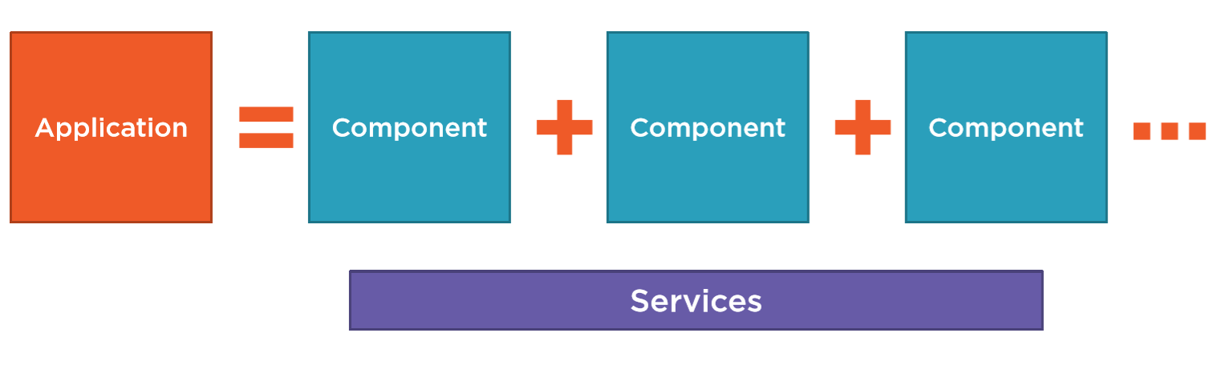
Anatomy of an Angular Application

Slide 6
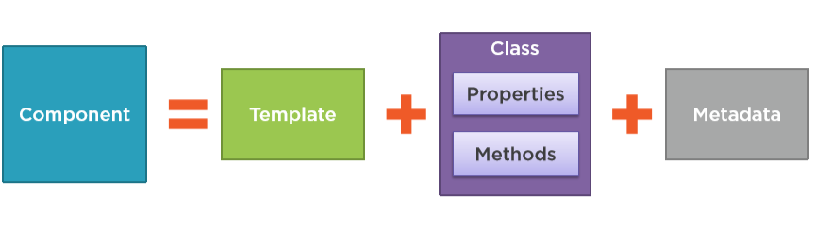
Component
Notes:
Html for the user interface fragment defining a view for the user
Component is a view defined by a template, associated code defined with a class, and additional data

Slide 7
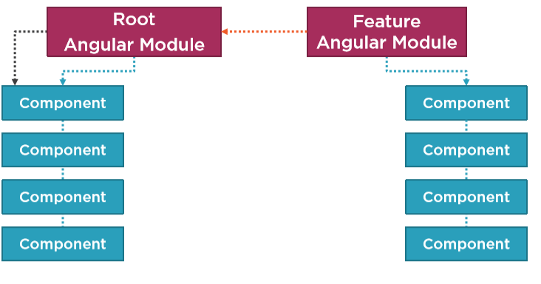
Angular Modules
Notes:
Angular modules help us organize our application into a cohesive blocks of functionality
Alteast 1.

Slide 8
Setting up the environment
Npm
Set up the Angular Application
Notes:
Install npm. Node package manager

Slide 9
npm
Node Package Manager
Command line utility
Installs libraries, packages, and applications
Notes:
Npm is a comman line utililty that interacts with a repository of open source projects
Npm package mangager for js

Slide 10
Setting up an Angular Application
Create an application folder
Add package definition and configuration files
Install the packages
Create the app’s Angular Module
Create the main.ts file
Create the host Web page (index.html)

Slide 11
Setting up an Angular Application
Angular CLI
Starter files
Notes:
Angular cli is a comman line tool for generating the set of files and boilerplate codes for angular

Slide 12
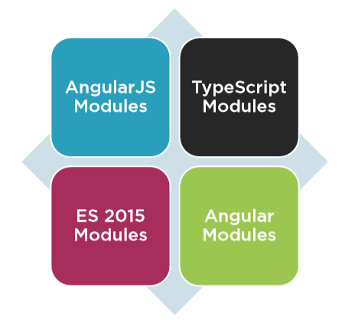
Modules
Notes:
No namespaces
No code organization

Slide 13
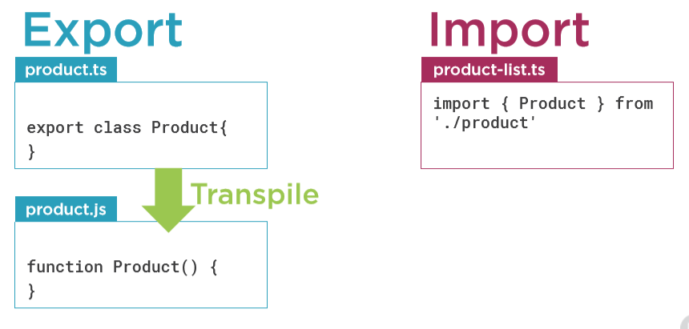
ES 6 Modules

Slide 14
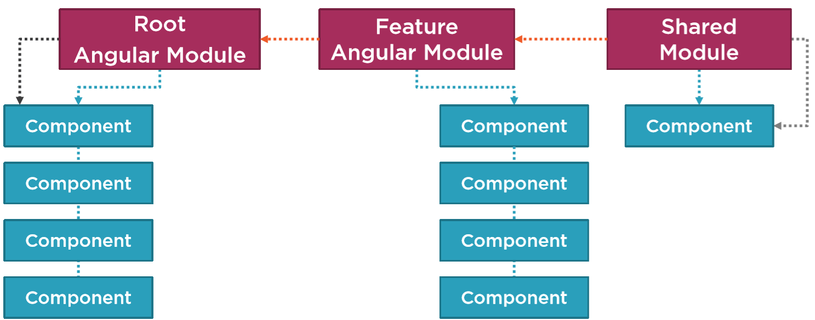
Angular Modules

Slide 15
Modules
ES Modules | Angular Modules
Code files that import or export something | Code files that organize the application into cohesive blocks of functionality
Organize our code files | Organize our application
Modularize our code | Modularize our application
Promote code reuse | Promote application boundaries
s

Slide 16
Introduction to Components

Slide 17
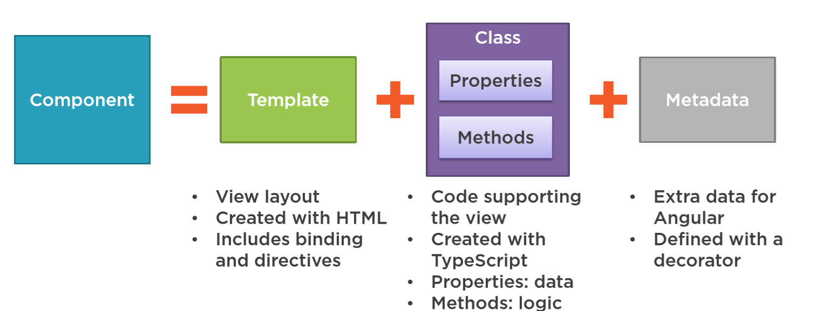
What is a Component?

Slide 18
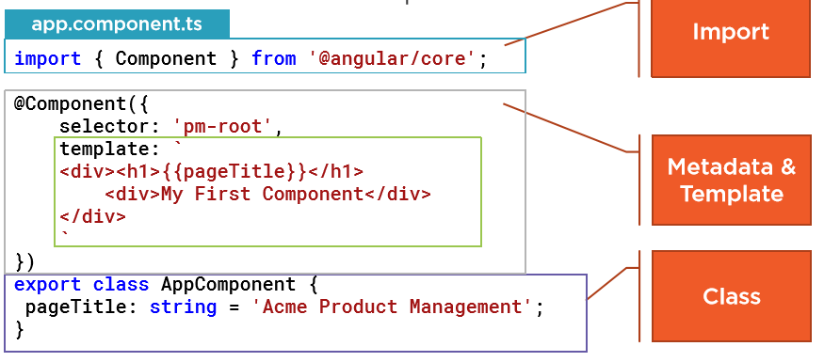
Component

Slide 19
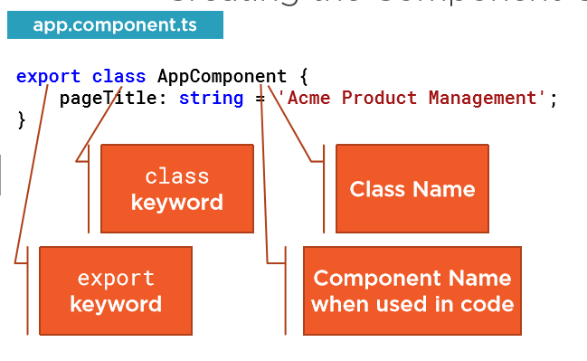
Creating the Component Class

Slide 20
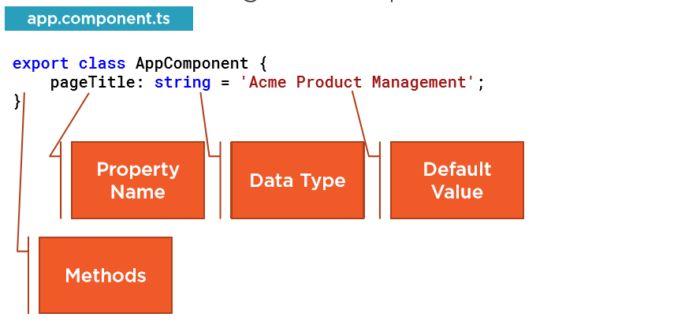
Creating the Component Class

Slide 21
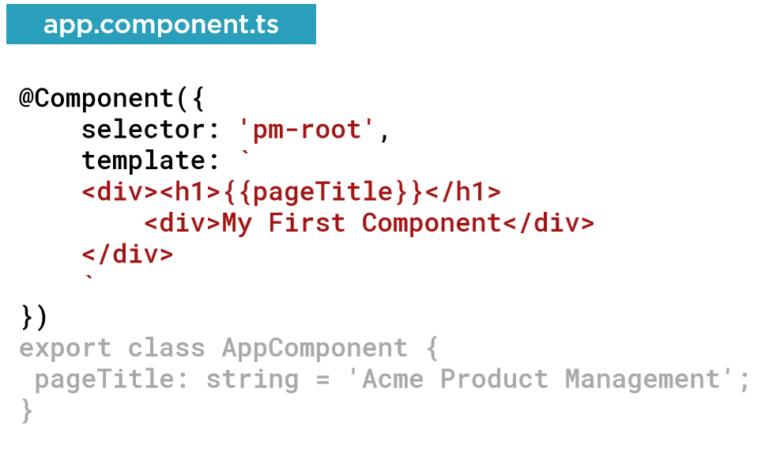
Defining the Metadata

Slide 22
Decorator
A function that adds metadata to a class, its members, or its method arguments
Prefixed with an @
Angular provides built-in decorators
@Component( )

Slide 23
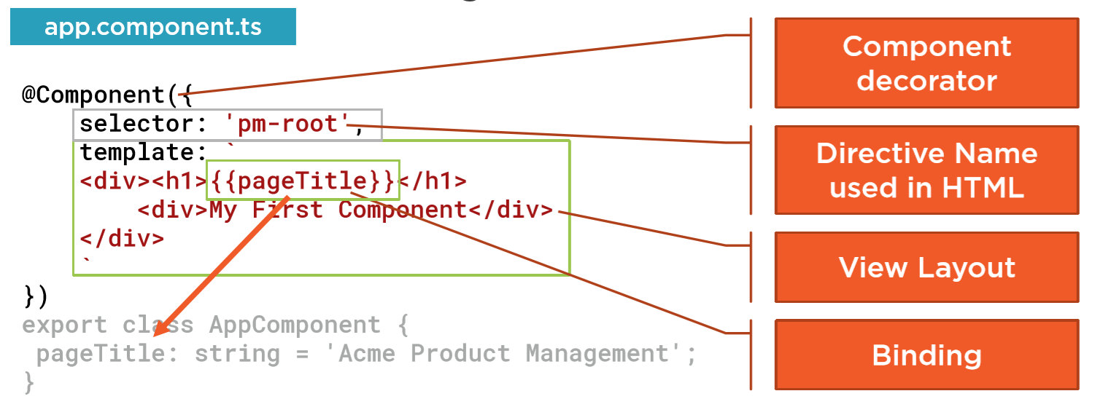
Defining the Metadata

Slide 24
Importing what we need
Import statement
External ES modules
Third-party library
Own ES modules
Angular modules

Slide 25

Angular is Modular

Slide 26
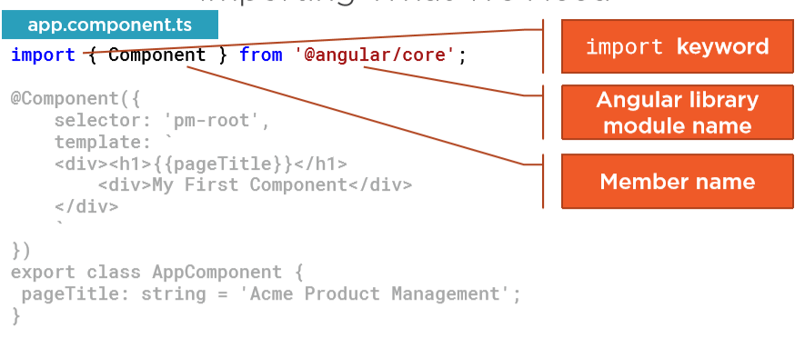
Importing what we need

Slide 27
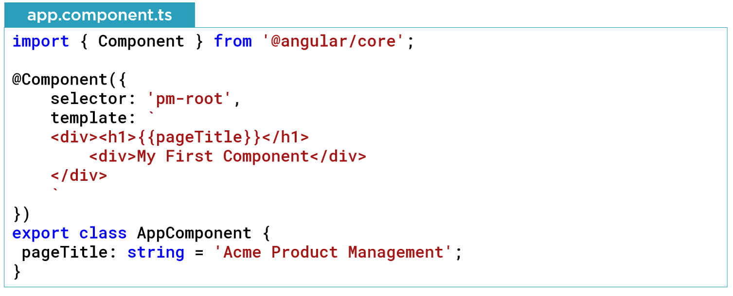
Completed Component

Slide 28
Single Page Application (SPA)
Index.html contains the main page for the application
This is often the only web page of the application
Angular application is often called a Single Page Application (SPA)

Slide 29
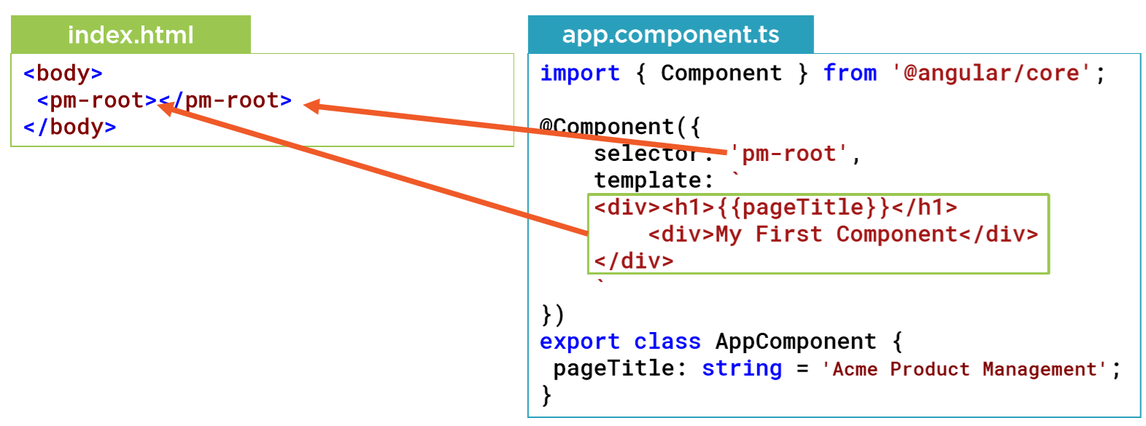
Hosting the Application

Slide 30
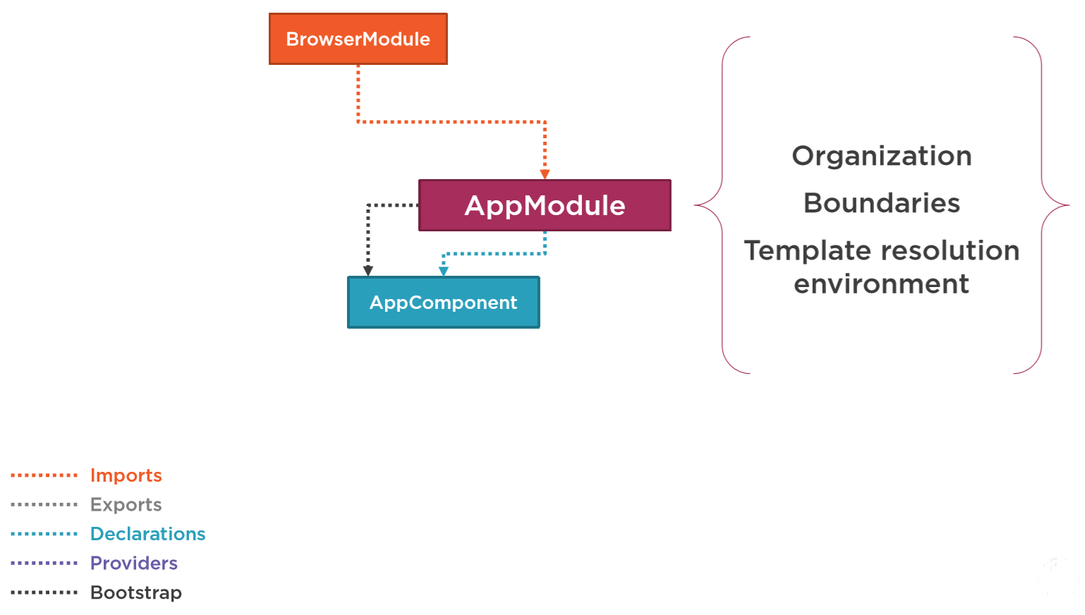

Slide 31
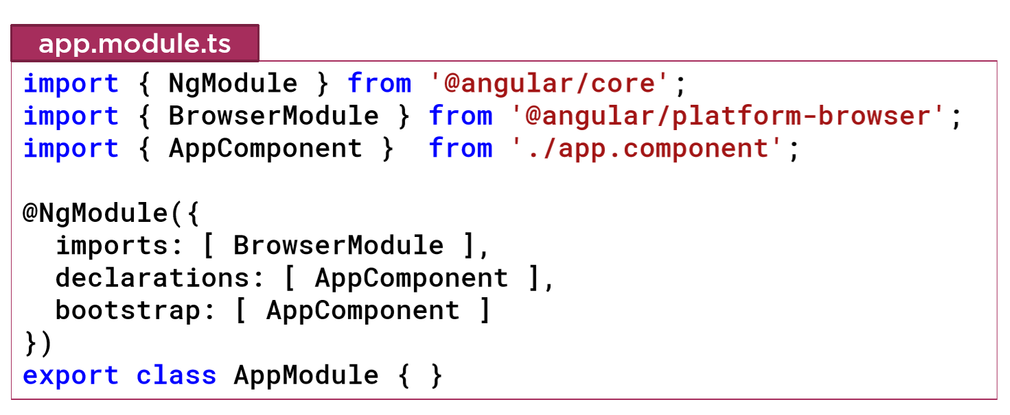
Defining the Angular Module

Slide 32
Component Checklist
Class -> Code
Decorator -> Metadata
Import what we need

Slide 33
Component Checklist: Class
Clear name
Use PascalCasing
Append “Component” to the name
export keyword
Data in properties
Appropriate data type and default value
camelCase
Logic in methods
camelCase

Slide 34
Component Checklist: Metadata
Component decorator
Prefix with @; Suffix with ( )
selector: Component.name in HTML
Prefix for clarity
Template: View’s HTML
Correct HTML syntax

Slide 35
Component Checklist: Import
Defines where to find the members that this component needs
Import keyword
Member name
Correct spelling/casing
Module path
Enclose in quotes
Correct spelling/casing

Slide 36
Something’s wrong! Checklist
F12 is your friend
Recheck your code
HTML
Close tags
Angular directives are case sensitive
TypeScript
Close braces
TypeScript is case sensitive

Slide 37
Templates, Interpolation, and Directives

Slide 38
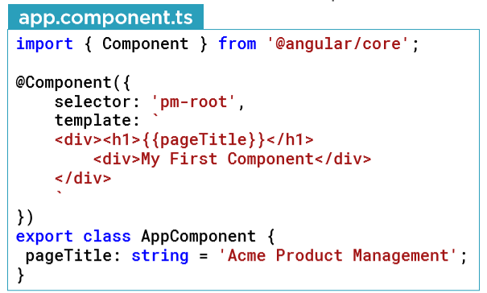
Component

Slide 39
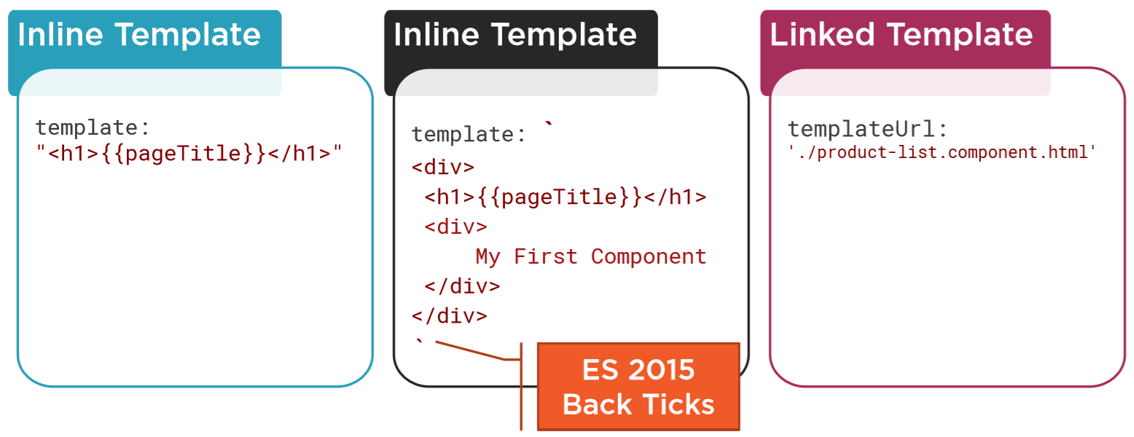
Defining a Template in a Component

Slide 40
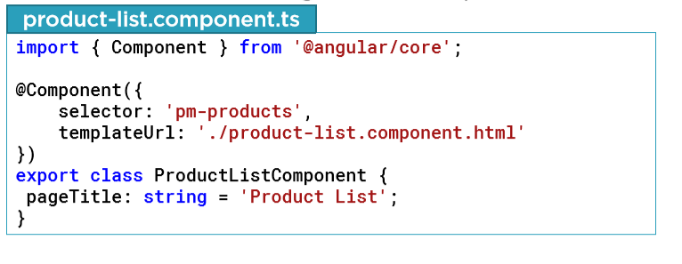
Building the Component

Slide 41
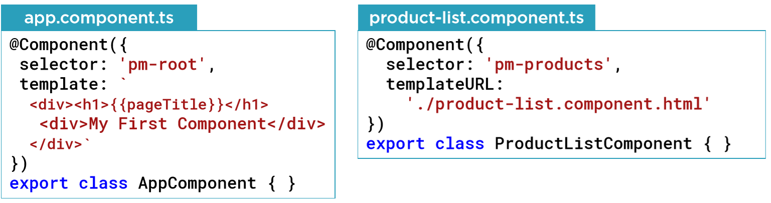
Using a Component as a Directive

Slide 42
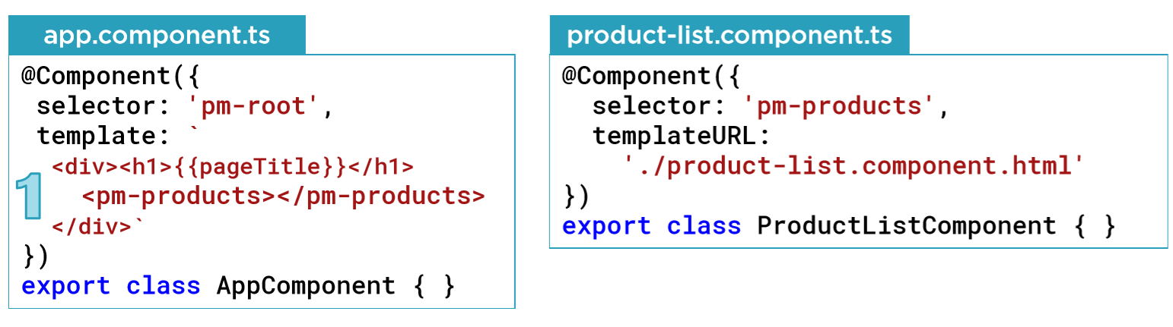
Using a Component as a Directive

Slide 43
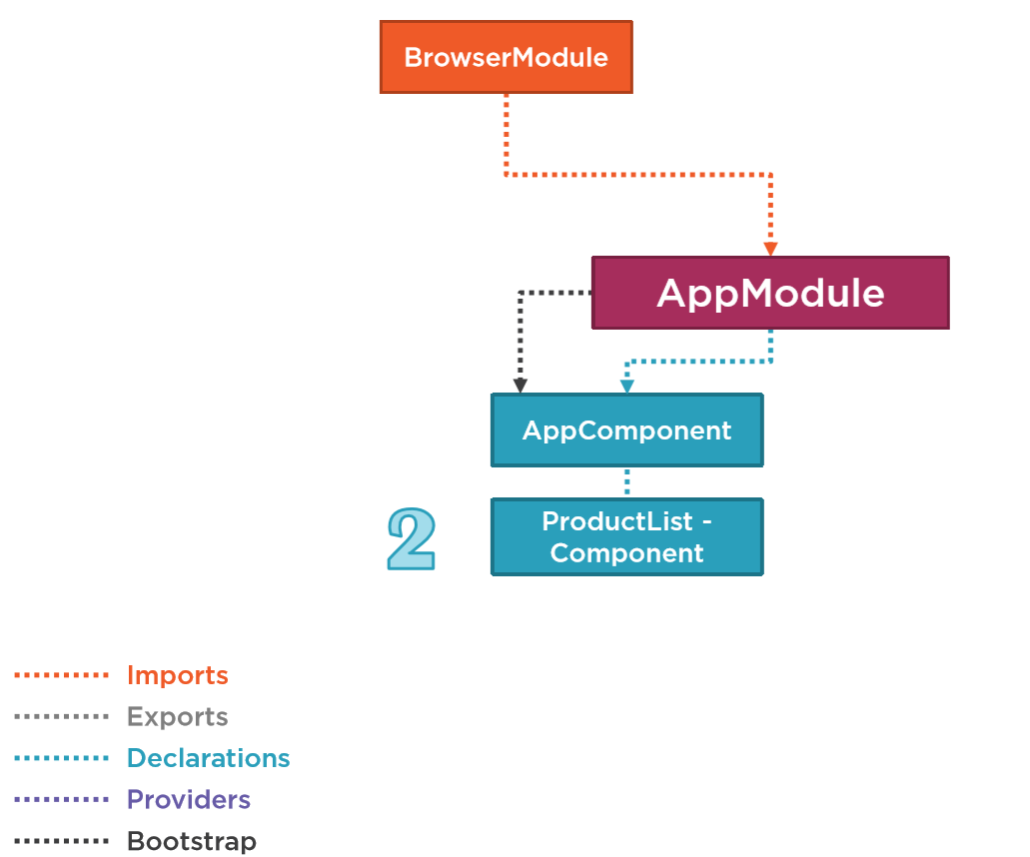

Slide 44
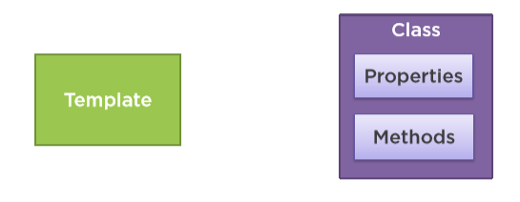
Binding
Coordinates communication between the component’s class and its template and often involves passing data

Slide 45
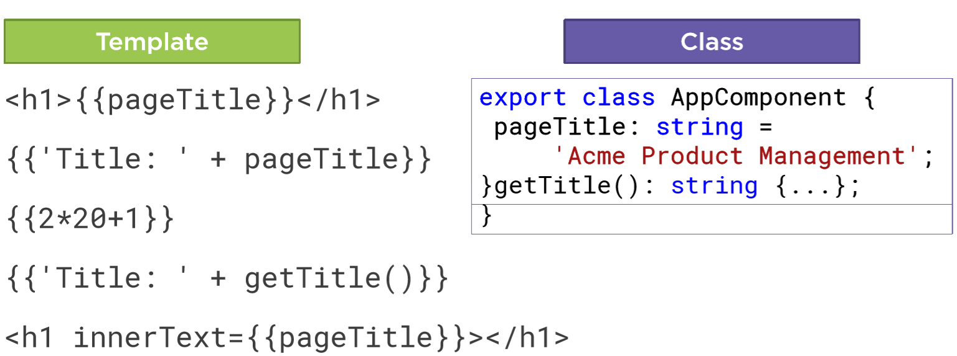
Interpolation

Slide 46
Directive
Custom HTML element or attribute used to power up and extend our HTML
Custom
Built-in

Slide 47
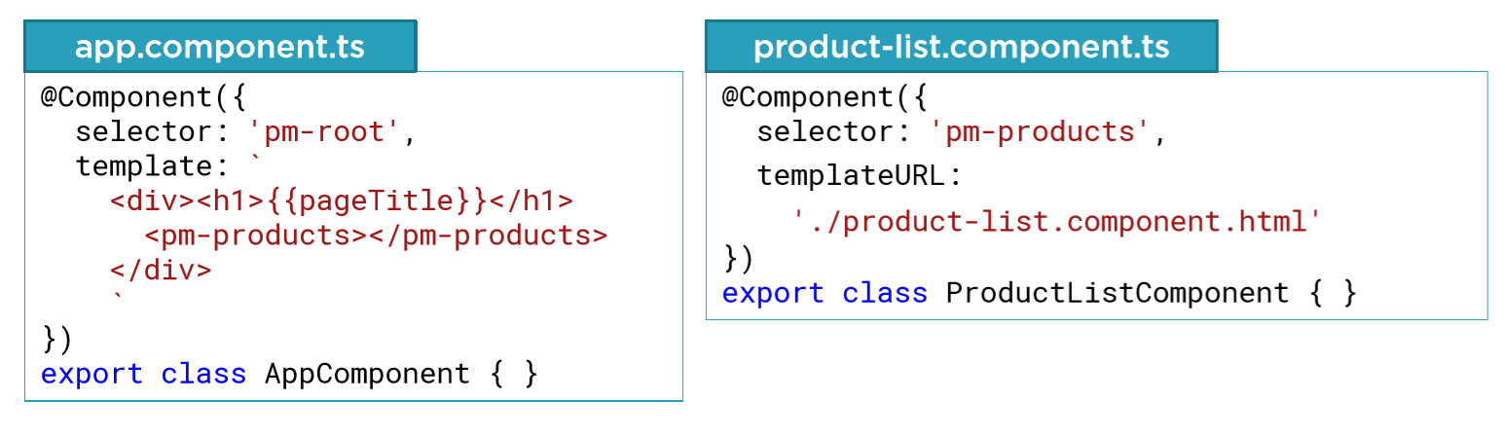
Custom Directives

Slide 48

Angular Built-in Directives

Slide 49
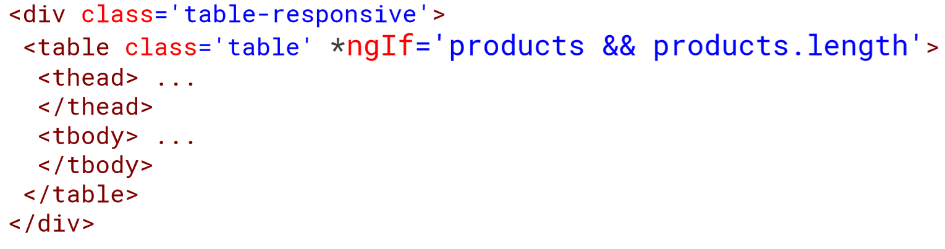
*ngIf Built-in Directive

Slide 50
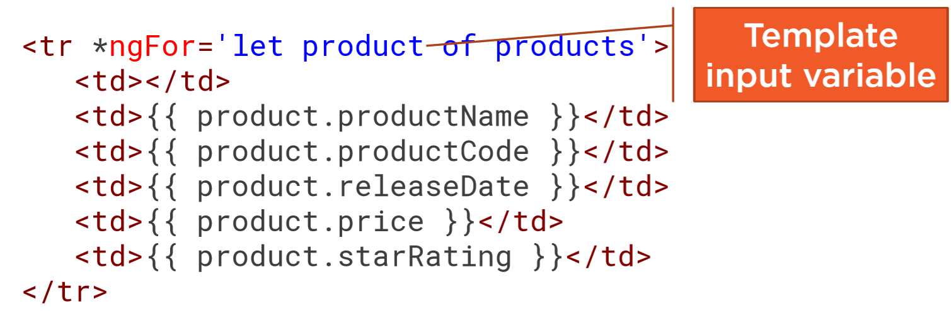
*ngFor Built-in Directive

Slide 51
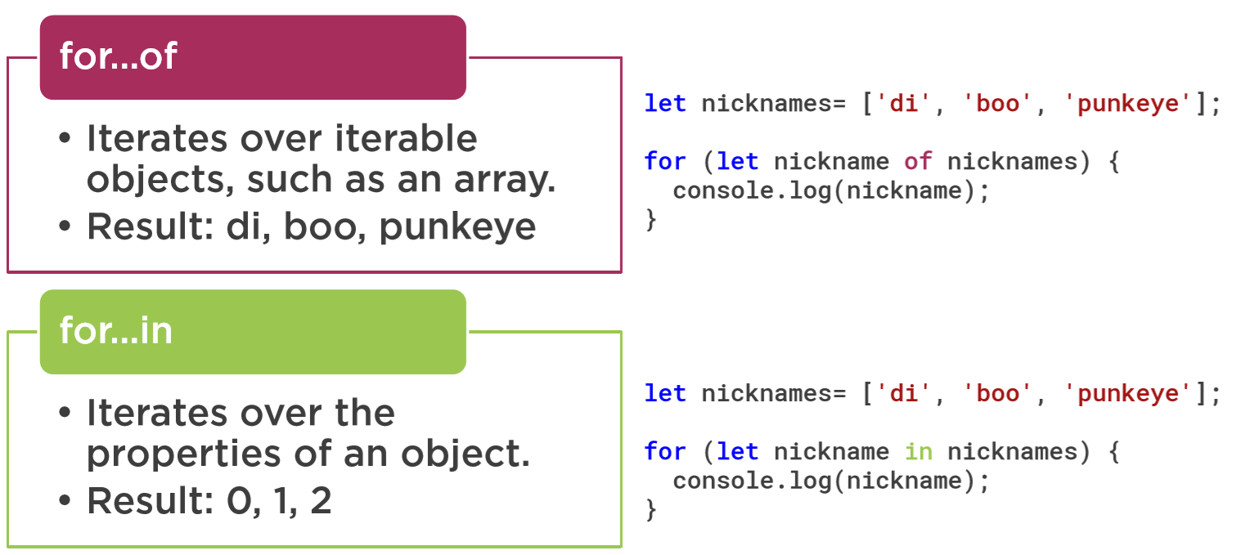
for…of vs for…in

Slide 52
Checklist: Template
Inline template
For short templates
Specify template property
Use ES6 back ticks for multiline
Linked template
For longer templates
Specify templateUrl property

Slide 53
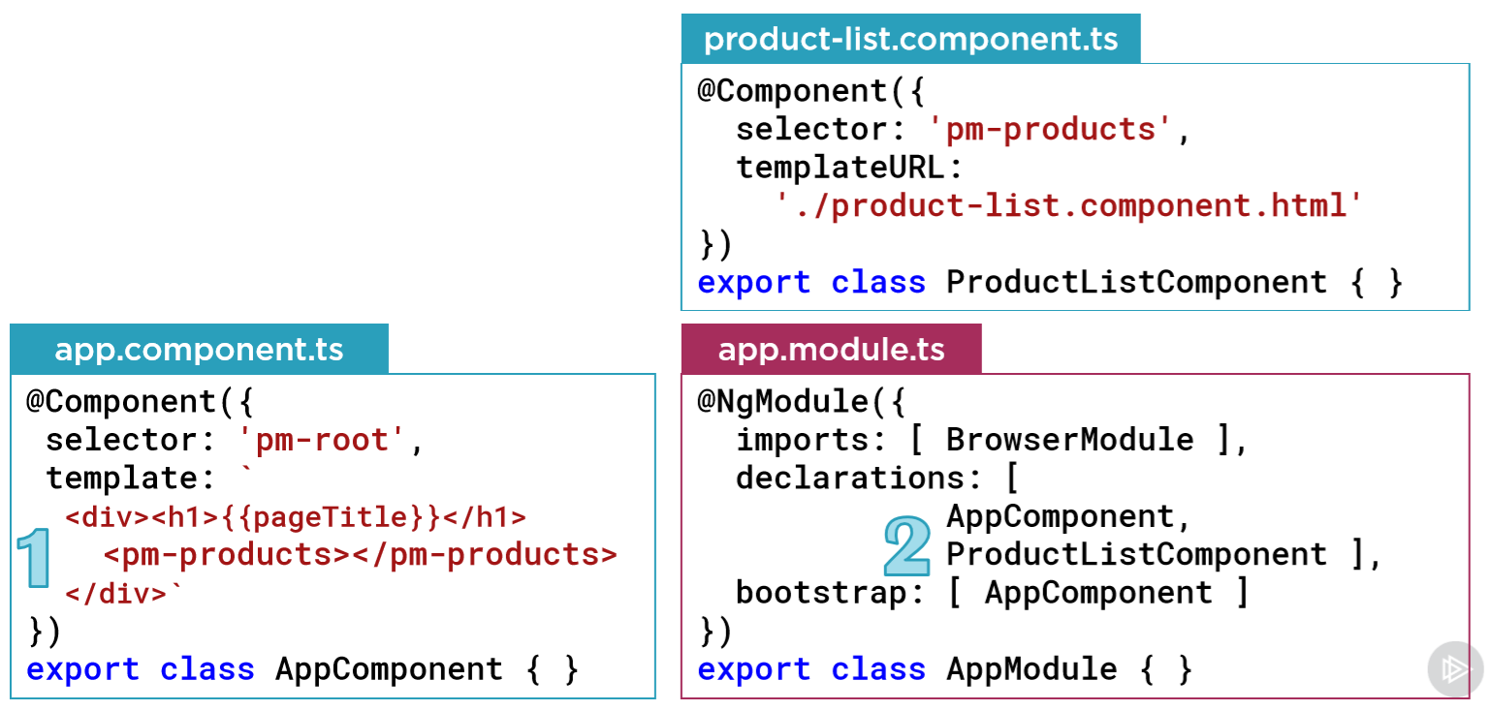
Checklist: Component as a Directive

Slide 54
Checklist: Interpolation
One way binding
From component class property to an element property
Defined with double curly braces
Contains a template expression
No quote needed

Slide 55
Checklist: Structural Directives
*ngIf and *ngFor
Prefix with an asterisk
Assign to a quoted string expression
*ngIf
Expression is evaluated as a true or false
*ngFor
Define the local variable with let
Use for…of

Slide 56
Data Binding & Pipes

Slide 57
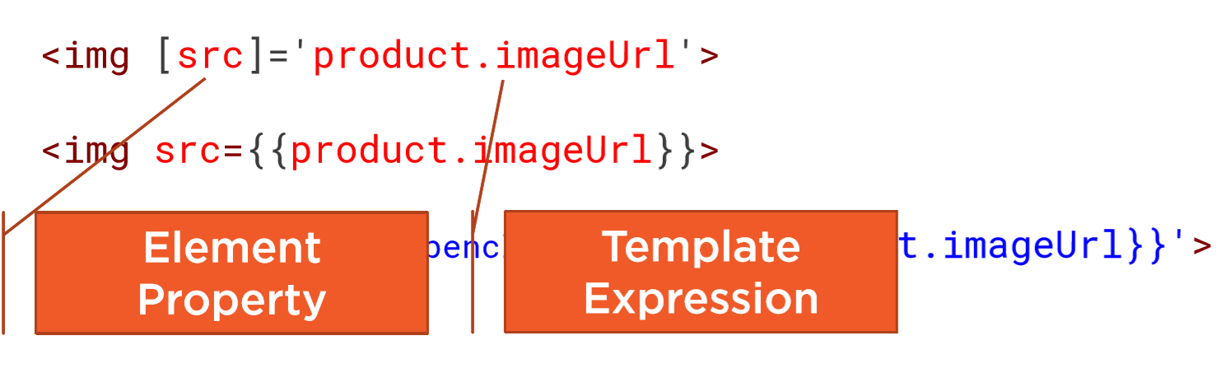
Property Binding

Slide 58
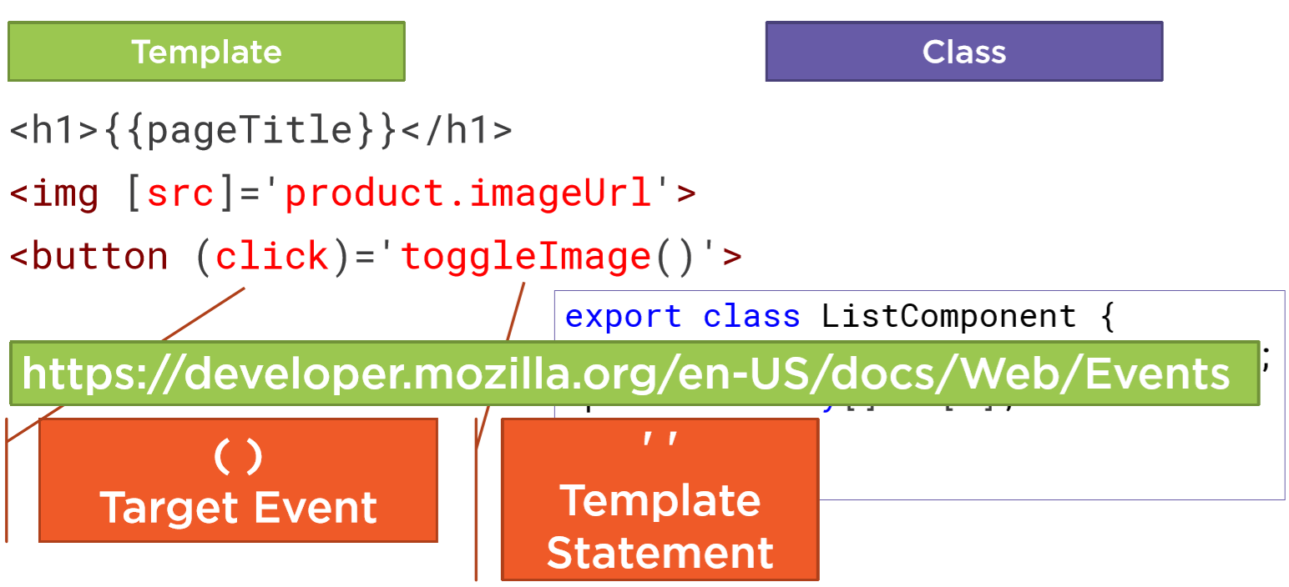
Event Binding

Slide 59
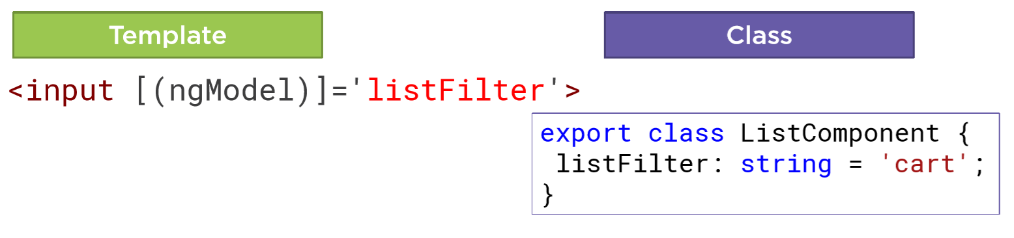
Two-way Binding

Slide 60
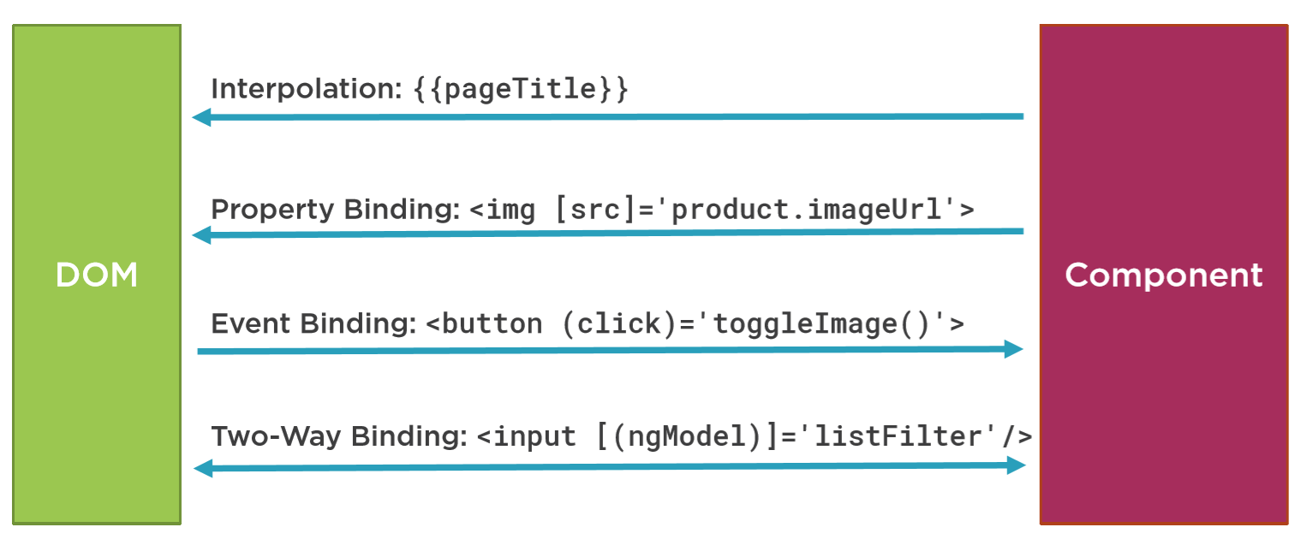
Data Binding

Slide 61
Transforming Data with Pipes
Transform bound properties before display
Built-in pipes
Date
Number, decimal, percent, currency
Json, slice
Custom pipes

Slide 62
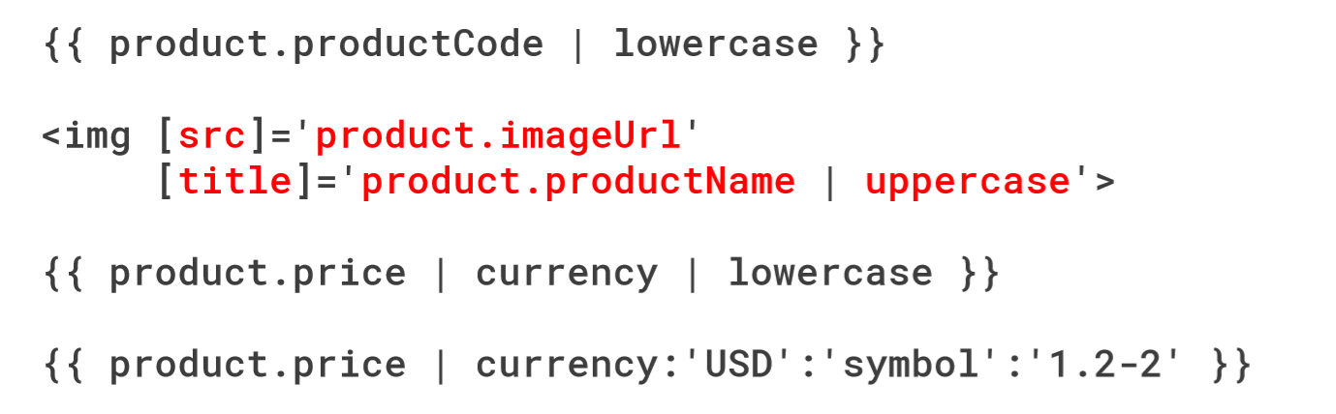
Pipe examples

Slide 63
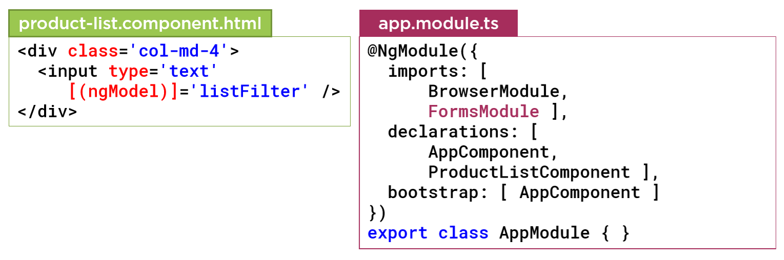
Checklist: ngModel

Slide 64
Checklist: Pipes
Pipe character |
Pipe name
Pipe parameters
Separated with colons
Example
{{ product.price | currency: ‘USD’ : ‘symbol’ : ‘1.2-2’ }}

Slide 65
More on Components

Slide 66
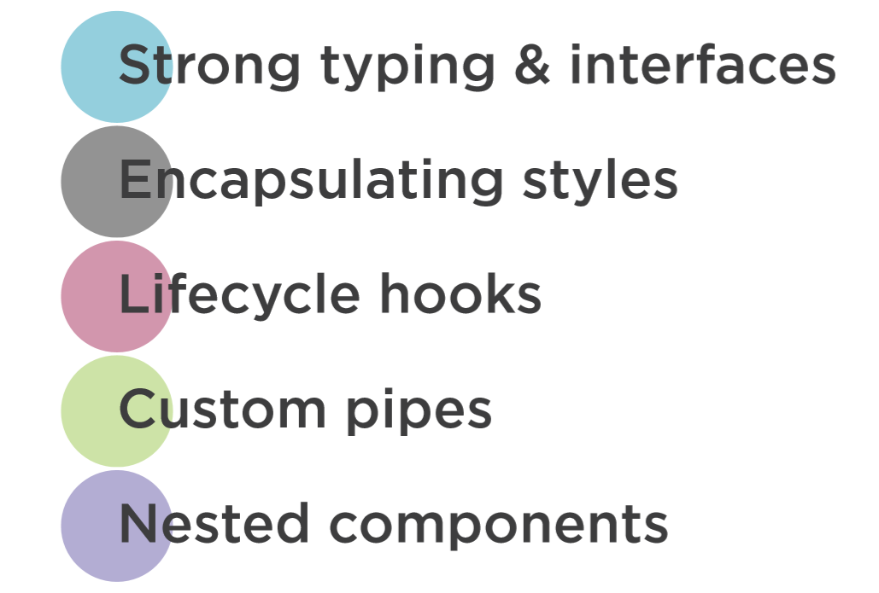
Improving Our Components

Slide 67
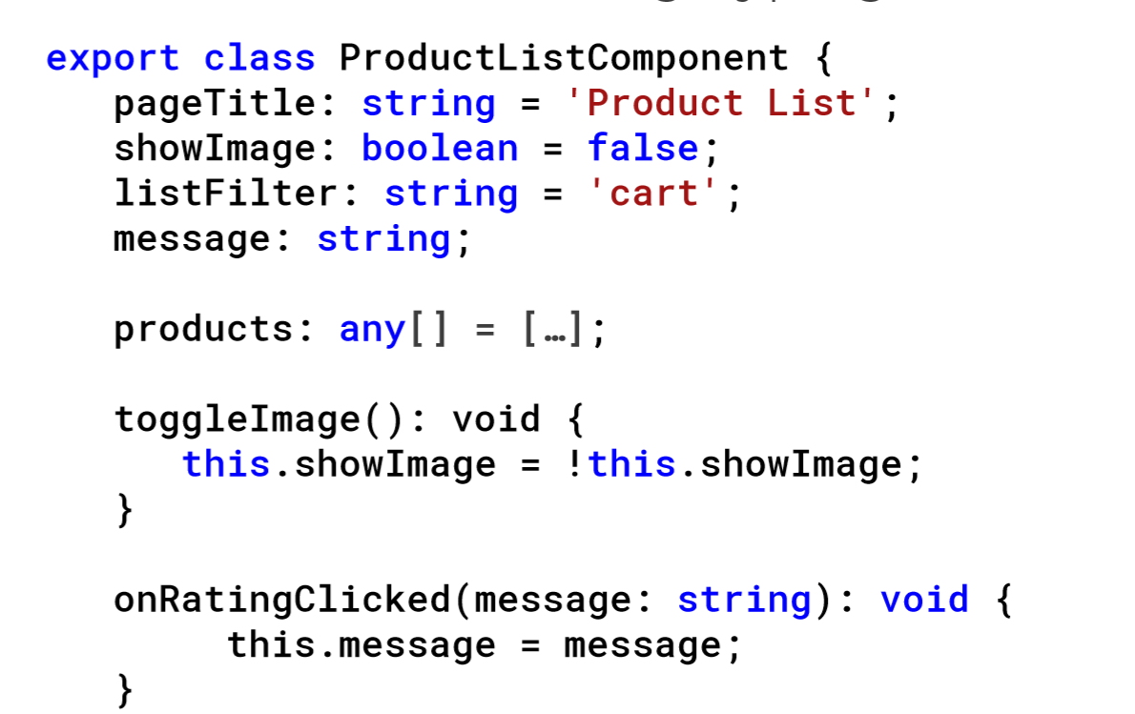
Strong Typing

Slide 68
Interface
A specification indentfying a related set of properties and methods.
A class commits to supporting the specification by implementing the interface
Use the interface as a data tyoe
Development time only!

Slide 69
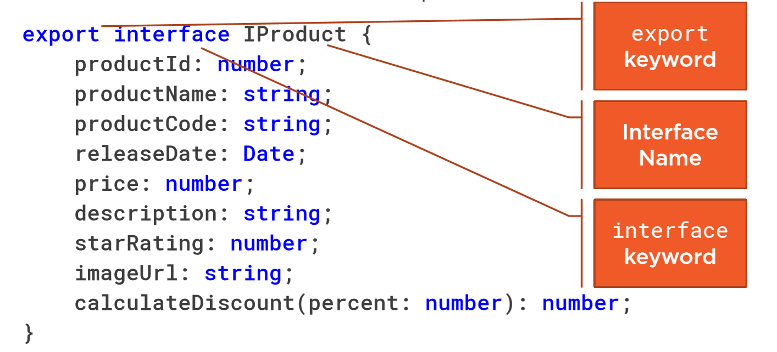
Interface is a Specification

Slide 70
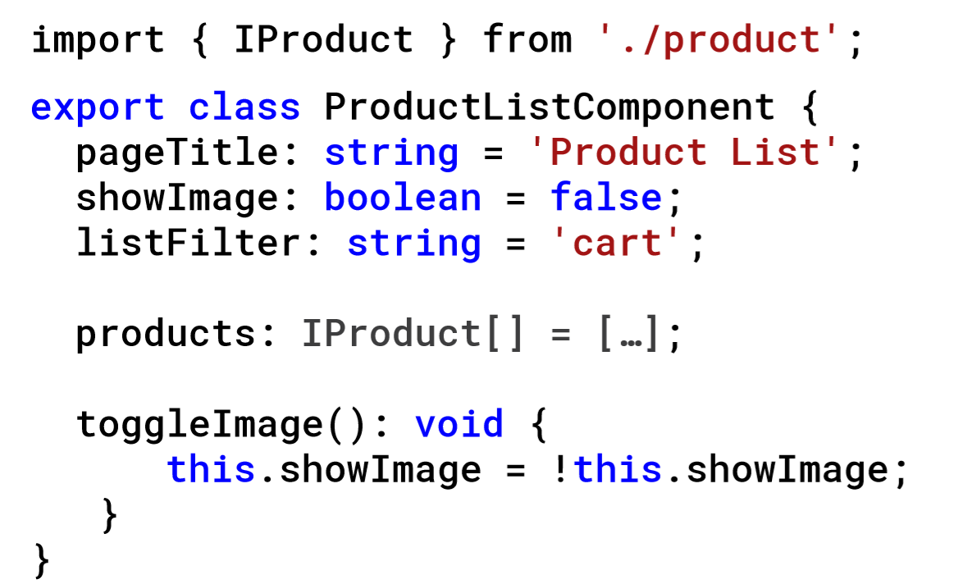
Using an Interface as a Data Type

Slide 71
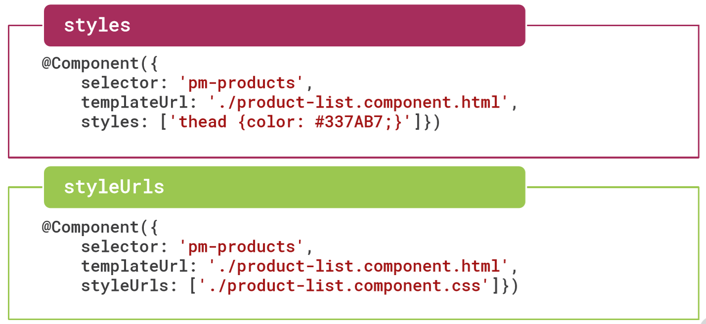
Encapsulating Component Styles

Slide 72
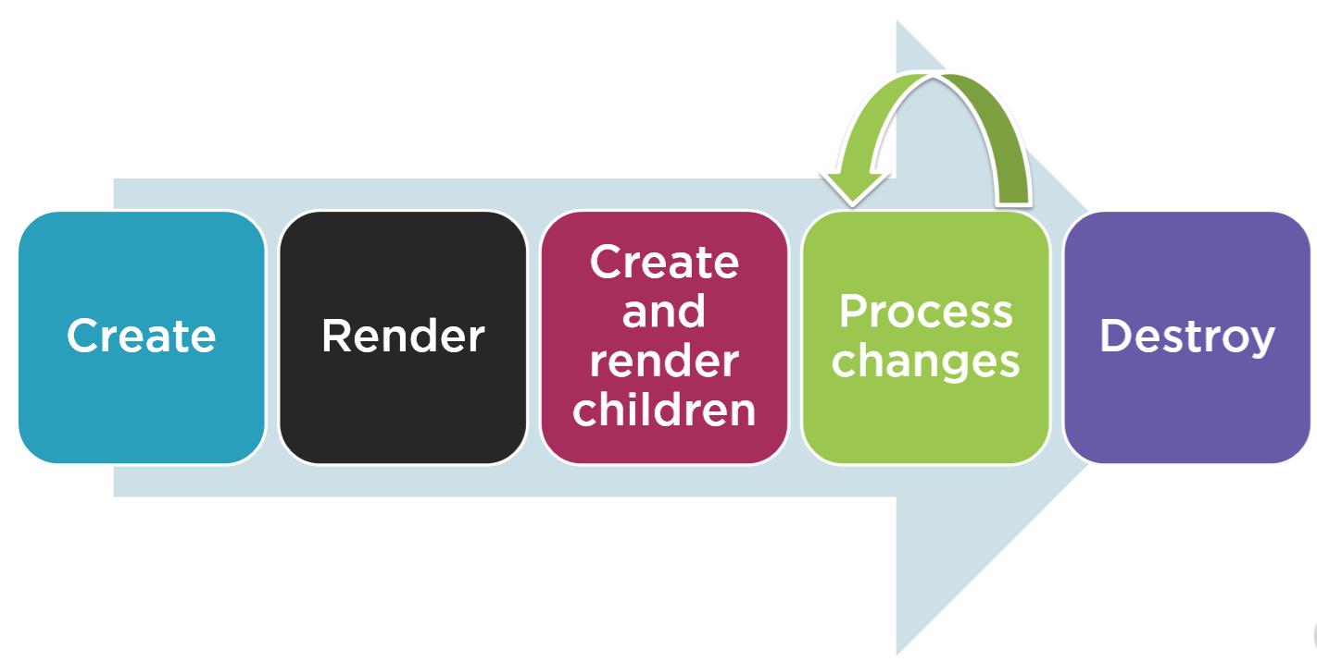
Component Lifecycle

Slide 73
Component Lifecycle hooks
OnInit: Perform component initialization, retrieve data
OnChanges: Perform action after change to input properties
OnDestroy: Perform cleanup

Slide 74
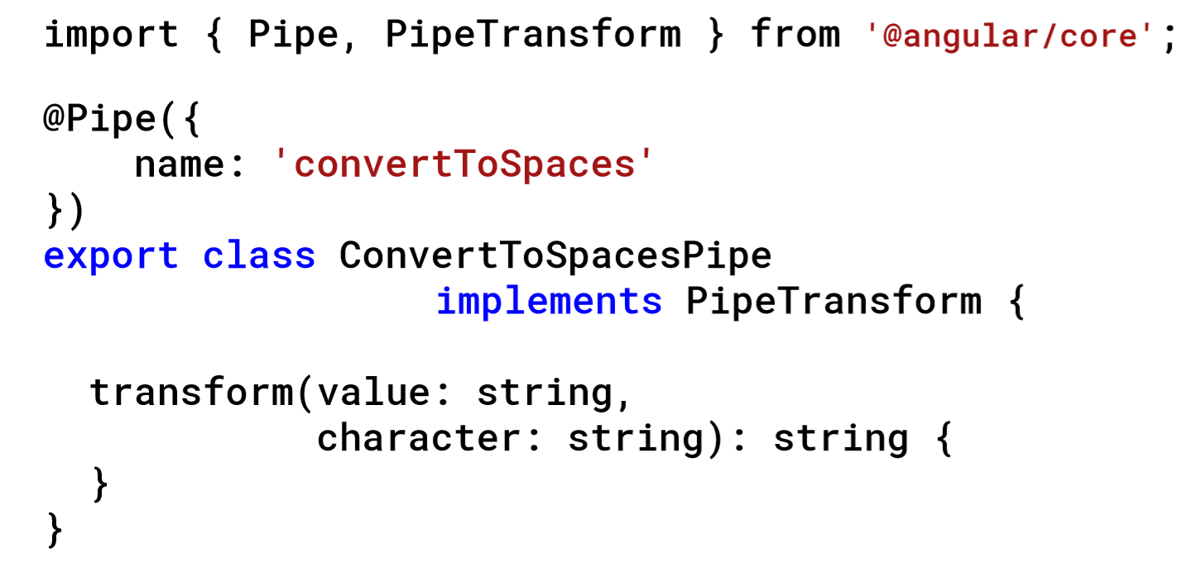
Building a Custom Pipe

Slide 75
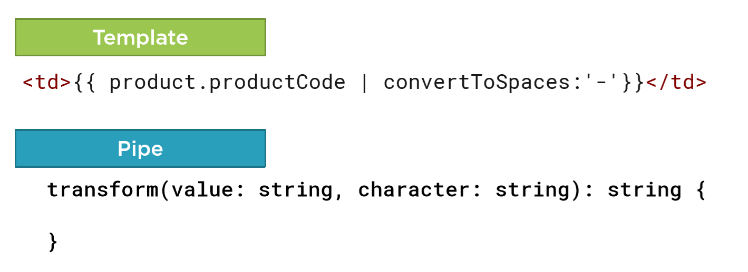
Using a Custom Pipe

Slide 76
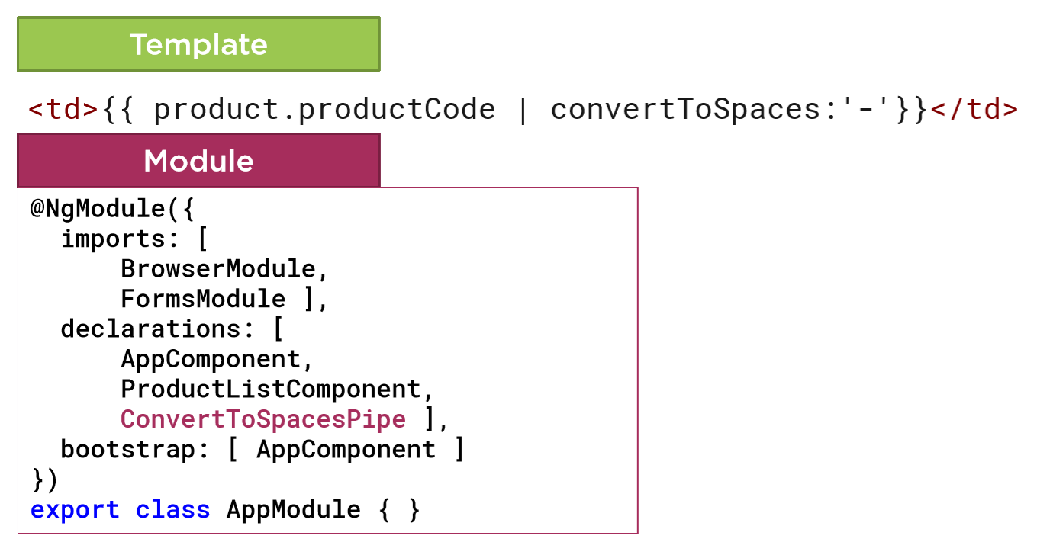
Using a Custom Pipe

Slide 77
Checklist: Interfaces
Defines custom types
Creating interfaces:
interface keyword
Export it

Slide 78
Checklist: Encapsulating Styles
Styles property
Specify an array of style strings
styleUrls property
Specify an arra of stylesheet paths

Slide 79
Checklist: Using Lifecycle hooks
Import the lifecycle hook interface
Implement the lifecycle hook interface
Write code for the hook method

Slide 80
Checklist: Building a Custom Pipe
Import Pipe and Pipe Transform
Create a class that implements PipeTransform
Export the class
Write code for the Transform method
Decorate the class with the Pipe decorator

Slide 81
Checklist: Using a Custom Pipe
Import the custom pipe
Add the pipe to the declarations array of an Angular module
Use the Pipe in the template
Pipe character
Pipe name
Pipe arguments

